Slide 1



BizWizards Consulting Co
Increase Parcel Business Through Targeted 3PL Parternership

Slide 2
Storyset
Business Analysist
PARUL
Market Analysts
SMIT
Communication coordinator
FEBIN
Operational consultant
JAIRAJ
Strategy Consultant
SOUKAINA
Market Analysts
KUNJ

Slide 3




Agenda
Table of Contents
Company Overview
01
Propose Solution
05
Core Problem
02
Conclusion
06
Market Review/Research
03
Q&A
07
Alternatives
04

Slide 4






01
Company

Slide 5


Your logo
Our Company
Since 1867, Canada Post has been a vital communication hub, evolving from traditional postal services to a comprehensive logistics and e-commerce facilitator. Now, it navigates the challenge of adapting to the digital age while balancing traditional mail services amidst the surge of e-commerce dominance.

Slide 6












148 %(2019 2022)
growth in canadian retail ecommerce sales
60% in 2022
online purchases vrs 2019
17 million
unmatched reached of addresses

Slide 7





Understanding the Problem
Logistics Challenges in Urban and Rural Areas
Competition from Private Couriers
E-commerce Surge and Market Share Loss
Urban, rural logistics hurdles impact delivery, hinder sales.
Private couriers challenge Canada Post's market share growth.
E-commerce growth pressures Canada Post, risking market share loss.

Slide 8





Market Research
Outreach
Canada Post 18%
UPS 18%
Purolator 13%
FedEx 8%
TFI International 4%
Others 39%

Slide 9
Canada Post and UPS were the leading parcel shipping providers in Canada in 2022, with 18% of parcels shipped by both companies
The Canadian package delivery company Purolator came second, with 13%

Slide 10
Analysis
With post offices within 5 km of 91% of canadians, we make returns abreeze

Slide 11


58%
of canadian apartment and condo residents prefer to have canada post deliver their online orders- 8 point higher than the canadian market average (50%)

Slide 12





Canada Post’s values are founded on three principles: we matter as individuals, we matter to one another, and we matter to our country.

Slide 13
10.8 Trillion
By 2030, the value of the global cross border ecommerce market is forecast to reach :

Slide 14
Upcoming Goals
60 % better than last year
4% worse than last year
37 % same as last year
Ecommerce outlook for next year

Slide 15



Alternative

Slide 16
Our Solutions
Enhancing Service Offerings
Ensuring Reliability
01
02
Faster delivery, better tracking, convenient pickups
Consistent, reliable delivery builds loyalty, referrals.
Supporting Small Businesses
Embracing Environmental Stewardship
03
04
Tailored support aids small business shipping needs.
Sustainability boosts brand reputation, attracts environmentally-conscious consumers.

Slide 17

Benefits for Canada Post in Partnering with 3PLs:
Expanded Reach
Diverse Service Offerings
Cost Efficiency
Flexibility in Capacity Management
Innovation and Technology Integration

Slide 18





3pl sugge﻿stions
• EEKO 3PL
• InterFulfillment
• TFI International
• Drexel Industries
• Canada Cartage
• Bison Transport
• Canadian Alliance Terminals
• Loomis Express

Slide 19
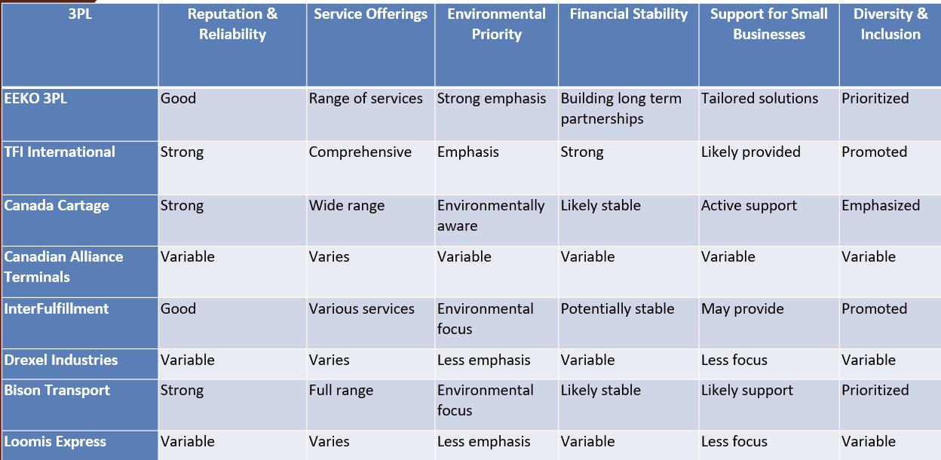
3PL Suggestions

Slide 20
Benefits for 3PLs in Partnering with Canada Post:
Unmatched reach to 17 million addresses
Canada comprehensive address and postal code database
Canadians trust Canada Post more than any other delivery company
Tracking experience: 44% of Canadian online shoppers will avoid repeat purchases with retailers after a poor tracking experience and 60% gen z online shoppers.
Access to National Infrastructure
Brand Association
Volume Discounts and Cost Savings
Market Expansion Opportunities
Operational Efficiency

Slide 21
Testimonials
Canada Post is not just a shipper to us. I see them as the partner. If we have an idea, we present it- and they are always receptive. We are working with great people who are great entrepreneur and look for ways to help.
Marc-Antoine Bovet
co founder oatbox
Oatbox

Slide 22
Testimonials
If you are only putting you money into one channel, you are missing an opportunity. When looking at customer retention, people who know you and your brand react really well when you send them something special through the mail.
Maxime Dubois
ceo Altitude sports
Altitude Sports

Slide 23
Testimonials
One of the things we like about Cnada Post is that apart from getting us into condo buildings, which are one of our big client segments, they also get our flyers into each resident’s mailbox- they don’t just throw on the lobby floor.
Tony Trew
(former) Marketing and Ecommerce Director, Structube
STRUCTUBE

Slide 24











Our Competitors

Slide 25
Upcoming Goals
10%
20%
30%
Growing sales from existing customers
Reducing cost to save money
Improve customer experience
Expand sales to canada outside market
Providing more delivery option

Slide 26

It takes a stronger canada post to deliver a stronger canada

Slide 27

37%
of canadians consider canada post to be the most sustainable delivery company in canada.

Slide 28

Thanks!
Do you have any questions?
bizWizardsconultancy@gmail.com
+91 620 421 838
bizWizards.com

